Slide 1

Antibody Stability in Atopic Dermatitis:
De-risking SC Biologics with Protease-Aware Models
A platform approach for antibody developers across IL-4Rα, IL-13, OX40, and related targets.

Slide 2
Industry Challenges
Therapeutic antibodies targeting IL-4Rα, IL-13, OX40, and related pathways are transforming atopic dermatitis (AD) care. However, subcutaneous (SC) administration exposes antibodies to protease-rich, inflammatory environments in AD skin, creating risks for degradation, loss of function, and variable patient responses. (Schuster et al., 2021)
Across IL-4Rα, IL-13, OX40 and related targets, atopic dermatitis skin presents unique challenges for monoclonal antibodies, including:
Elevated protease activity (e.g., neutrophil elastase, proteinase 3, cathepsin G) accelerates antibody degradation, possibly affecting antibody integrity and therapeutic effect.
SC administration increases exposure to destabilizing local factors such as pH, ionic strength, and extracellular matrix interactions.
Degradation can impair Fc-mediated functions and therapeutic binding, reducing clinical effectiveness.
Without targeted stability testing, late-stage or approved antibodies risk reduced efficacy in real-world use.

Slide 3
Why This Matters Now
Multiple biologics for AD are already approved or in Phase 2/3 trials (IL-4Rα, IL-13, OX40 mAbs).
Competition is intensifying: differentiation is no longer just efficacy, it is durability and dosing convenience.
Real-world settings differ from controlled clinical trial environments; protease-driven degradation may become more apparent post-approval.
Regulators and payers are placing greater emphasis on durability data and dosing frequency as determinants of value.
Developers who proactively demonstrate stability in disease-relevant environments gain competitive advantage.

Slide 4
The Effect of Subcutaneous interstitial Fluid on mAB Stability
The unique composition of SC tissue and prolonged presence of mAb in this environment can significantly impact their stability, safety, and effectiveness
SC fluid differs from plasma in pH, ionic strength, and protein content, potentially impacting mAb structure and stability
Local oxidative and reducing agents may trigger mAb oxidation or deamidation
SC administration keeps mAbs at the injection site, increasing exposure to destabilizing factors
Interaction with extracellular matrix components during diffusion may affect mAb integrity

Slide 5
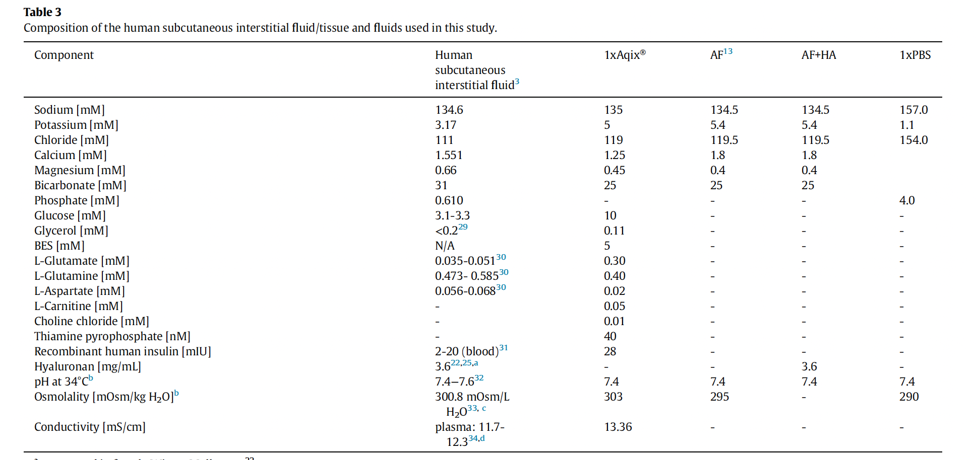
Subcutaneous (SC) Interstitial Fluid
The composition/environment of the SC can define mAb stability
AF: artificial fluid; AF+HA: artificial fluids+hyaluronan.
Recommend selecting from these
Schuster et al. (2021). Stability of monoclonal antibodies after simulated subcutaneous administration.

Slide 6
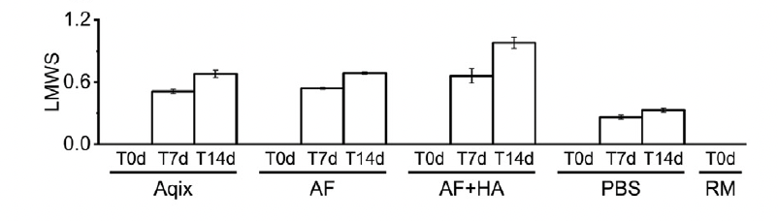
SC Interstitial Fluid and Antibody Degradation
High performance - size-exclusion chromatography (HPSEC): mAb was measured in four fluids at three time points. Low-molecular weight species (LMWS)
PBS buffers preserved molecule stability, relative to bicarbonate buffers, resulting in less aggregation, fragmentation, and particle formation
Bicarbonate buffers (such as Aqix, AF, and AF+HA) were more aggressive toward mAb stability, but are more representative of the in vivo subcutaneous environment.
AF and Aqix are promising buffers because:
  Remained stable throughout the incubation period
  They have physiologically relevant composition
  They allowed to detect stability differences between the tested mAbs
Schuster et al. (2021). Stability of monoclonal antibodies after simulated subcutaneous administration

Slide 7
iFyber’s Platform
Explore a tiered experimental platform designed to test and de-risk antibody stability:
In vitro protease challenge assays
Controlled exposure to relevant proteases (e.g., neutrophil elastase)
Ability to separate physicochemical vs. enzymatic degradation
Ex vivo human skin (Hyposkin model)
Human skin explants with hypodermis, viable >7 days
Mimics subcutaneous injection environment with natural immune cells
AD-specific ex vivo model
Replicates disease conditions: neutrophilic infiltration, elevated TSLP
Enables testing of antibody degradation in protease-rich AD tissue
Advanced analytics
SDS-PAGE, Western blot, ELISA for Fc/Fab integrity
LC-MS/MS to identify cleavage sites
Immunofluorescence to assess localization

Slide 8
Atopic Dermatitis
Atopic Dermatitis is:
Chronic inflammatory skin disease
Skin barrier dysfunction and immune dysregulation is observed
Infiltration of neutrophils, eosinophils, mast cells exist
Increased protease activity (kallikreins - KLK, and neutrophil proteases)
Common proteases in AD
Keratinocyte-derived: KLK5 and KLK7 (less relevant)
Neutrophil-derived:
  Neutrophil Elastase (NE): 35-fold increase in AD skin (Wiedow et al., 1992; Voegeli et al., 2009)
  Proteinase 3 (PR3) and Cathepsin G
***Contribute to inflammation, barrier damage, and degradation of therapeutic proteins***

Slide 9
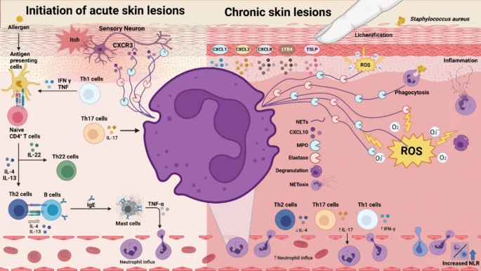
Atopic Dermatitis, cont.
The involvement of neutrophils in AD skin
Chiang et al. (2024). Neutrophils in Atopic Dermatitis

Slide 10
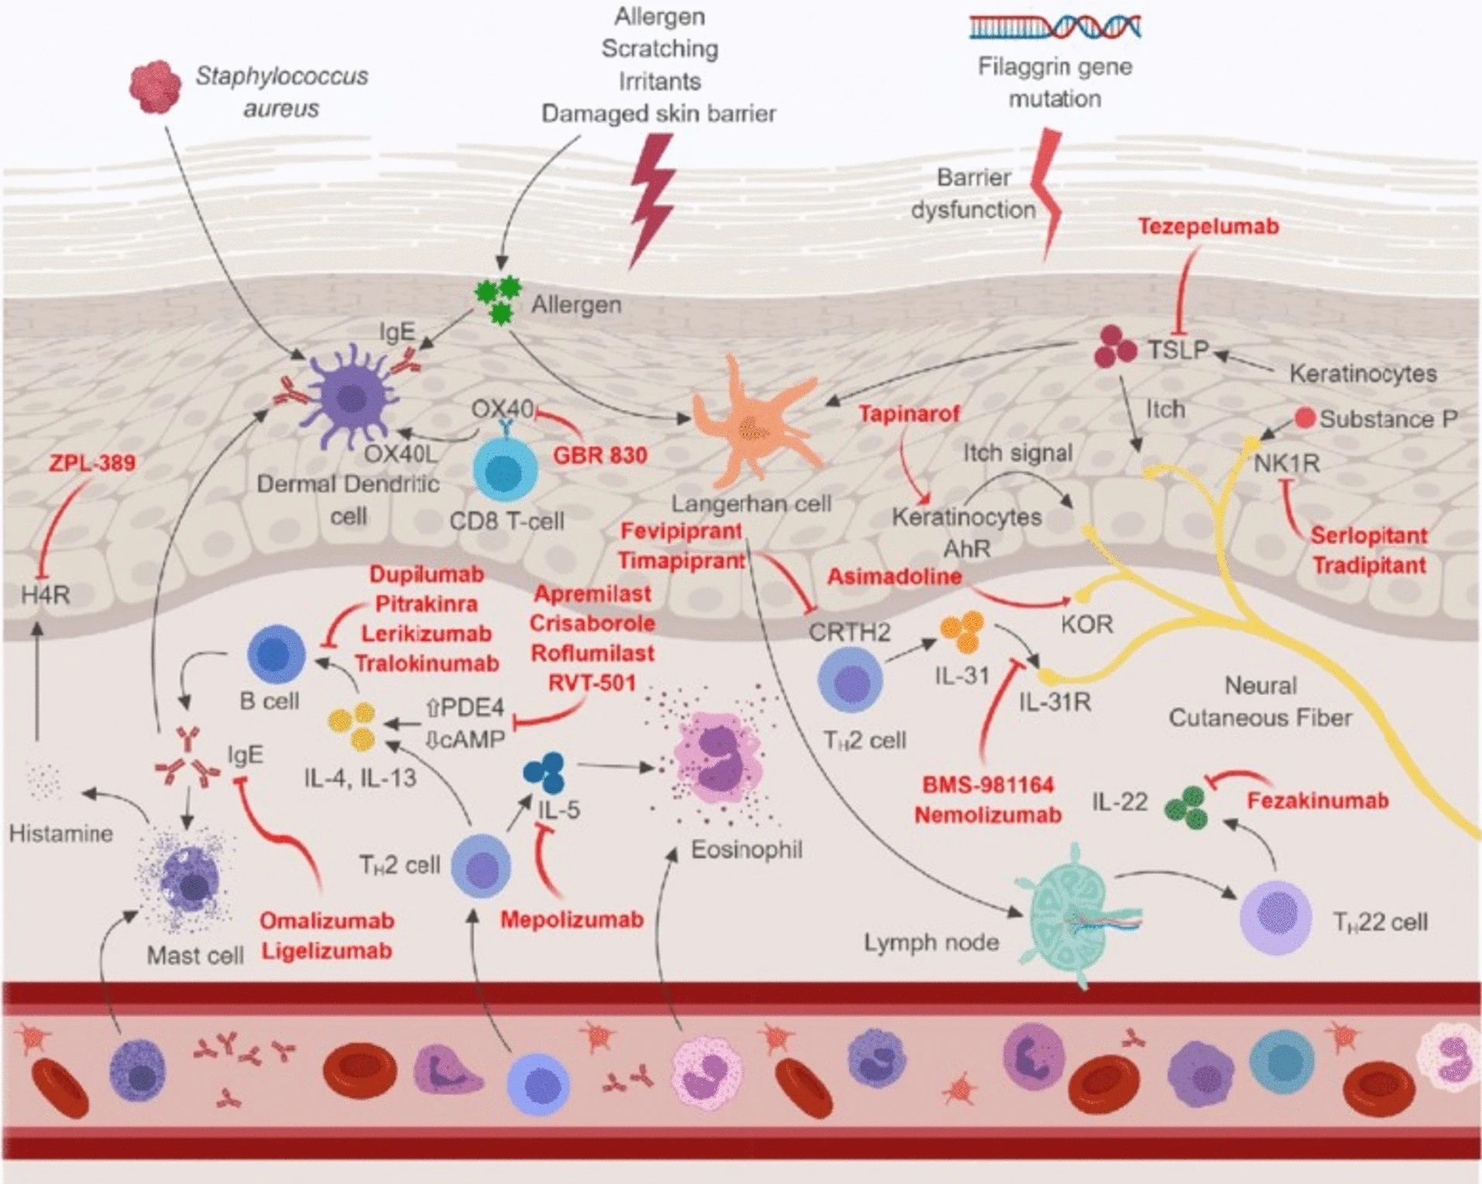
Atopic Dermatitis, cont.
Involvement of immune cells in the AD pathophysiology
mAbs are a common approach for the treatment of AD by targeting different molecules (cytokines, chemokines, receptors, etc.)
Abdel-Mageed (2025). Atopic dermatitis: a comprehensive updated review of this intriguing disease with futuristic insights

Slide 11
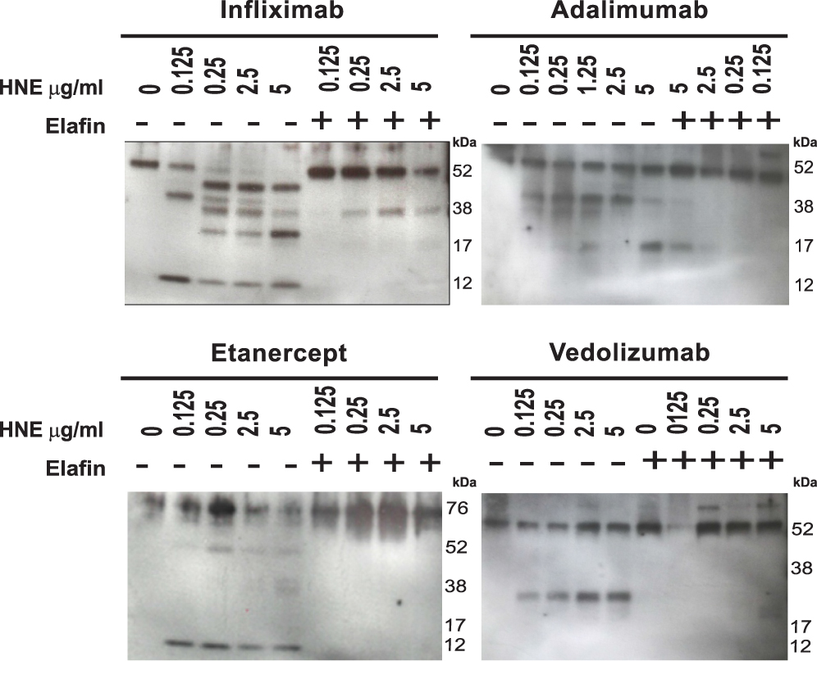
NE can Degrade AB
Immunoblotting analysis of infliximab, adalimumab, etanercept, and vedolizumab (all at 0.1 µg/mL) treated with increasing concentration of HNE (0–5 µg/mL), with or without recombinant elafin (5 µg/mL).
Recombinant human neutrophil elastase degrades different therapeutic monoclonal antibodies
Elafin prevents this degradation
Curciarello et al. (2020). Human Neutrophil Elastase Proteolytic Activity in Ulcerative Colitis Favors the Loss of Function of Therapeutic Monoclonal Antibodies

Slide 12
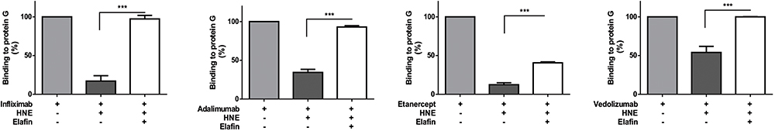
NE Promotes Loss of Fc Fraction of Therapeutic Abs
Loss of Fc fraction of the therapeutic monoclonal antibodies evaluated by ELISA. Infliximab, adalimumab, etanercept, or vedolizumab treated with HNE (for 24 h) or HNE plus elafin were incubated. Almost 80% of infliximab and etanercept binding, and 40 to 50% of adalimumab and vedolizumab binding to protein G was impaired by HNE digestion. The binding capacity of the four drugs to protein G was significantly rescued by elafin
Curciarello et al. (2020). Human Neutrophil Elastase Proteolytic Activity in Ulcerative Colitis Favors the Loss of Function of Therapeutic Monoclonal Antibodies

Slide 13
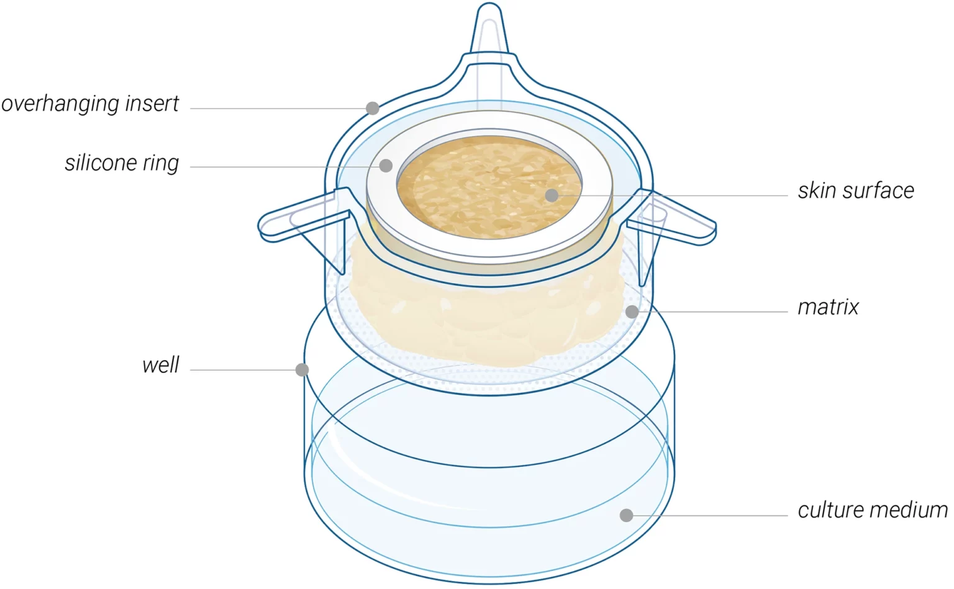
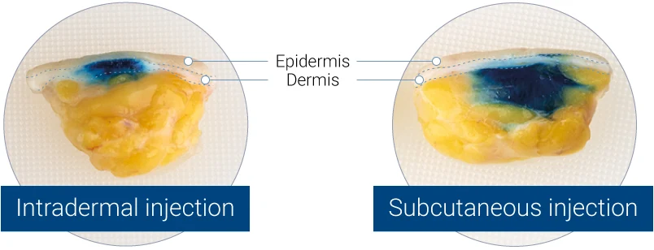
Hyposkin Model
Ex vivo human skin model designed for testing injectable therapeutics
Skin explants with hypodermis
Viable and functional for 7+ days
Contains 14 immune cell types naturally presented in human skin
Multiple administration routes
  Topical, subcutaneous and intradermal injections
  Systemic-like administration

Slide 14
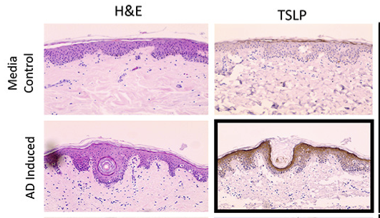
AD Skin Model
AD skin models can potentially be used to study mAb stability in a relevant system
AD ex vivo skin model characteristics (H&E)
Structural histological changes, along with disease-specific alterations in the expression of markers associated with the AD phenotype, such as Thymic Stromal Lymphopoietin (TSLP)
TLSP expression
Neutrophilic infiltration

Slide 15
Value for Developers
For Pharma:
De-risk lifecycle management of approved antibodies
Support formulation improvements and dosing interval extensions
For Biotech:
Strengthen IND regulatory packages
Provide validation data that attracts investors and partners
For Both:
Position as leaders by proactively addressing protease-mediated degradation risk
Demonstrate superior antibody durability and resilience under AD-relevant conditions

Slide 16
Proposed Approach (?)
Experimental approach – Overview
Degradation in vitro studies
  Incubate mAbs in artificial SC fluids
  Incubate mAbs with protease in relevant buffer (TBD)
    mAb stability in artificial SC fluid can be assessed in parallel with protease challenge to separate physicochemical instability from enzymatic degradation
  Analyze degradation products (WB, ELISA, LC/MS)
Bioavailability ex vivo studies
  Recommended skin model (ex vivo human viable skin)
    Hyposkin
    Ex vivo AD skin model
    AD Hyposkin model (development effort – can be done in parallel)

Slide 17
Proposed Approach (?)
In vitro study: interstitial fluid impact on antibodies stability
Incubation of mAb in artificial fluids mimicking SC interstitial fluid (Schuster et al., 2021)
  PBS
  1xAqix
  AF
Time points: 0, 7, and 14 days

Slide 18
Case Example
In vitro study: protease-driven degradation
Incubation mAbs with relevant proteases
Neutrophil Elastase (NE) (Optional: Proteinase 3 (PR3) and cathepsin G / Activated neutrophil supernatants)
Condition | Elastase Concentration | Rationale
Moderate (mild AD) | 1.0 µg/mL | Represents modest increase seen in subacute or mild AD (5–10× normal skin)
High (severe AD) | 5.0 µg/mL | Mimics inflamed skin with intense neutrophil infiltration (Curciarello et al., 2020)
Maximal stress | 10.0 µg/mL | Pushes enzymatic degradation to limits; used to test Ab stability under AD-like stress
Time points: 1, 4 and 24 h for each concentration
Optional: Elafin co-treatment (5 µg/mL) as a rescue/control condition to validate specificity
Detection Methods
SDS-PAGE and Western Blot for antibody fragmentation
ELISA for Fc or Fab domains
LC-MS/MS to identify cleavage fragments

Slide 19
Proposed Approach (?)
Ex vivo degradation studies
Antibody administration in ex vivo skin
  Subcutaneous injections – define sites and amount
  Fluorescent labeled or biotinylated antibodies, if localization is necessary
Detection methods
SDS-PAGE and Western Blot for antibody fragmentation
Immunofluorescence to assess tissue localization
LC-MS/MS to identify cleavage fragments

Slide 20
Proposed Approach (?)
Experimental design: in vitro studies
Incubation in artificial SC fluids
Groups: mAb (3 concentrations)
SC fluids: 2 (1xAqix and AF)
Time points: 3 (0, 7 and 14 days)
Replicates: 2
Total: 3 (concentrations) x 2 (SC fluids) x 3 (time points) x 2 (replicates) = 36 samples
Incubation with NE
Groups: mAbs (control), mAb + NE (3 concentrations of mAb)
NE concentrations: 3 (1, 5 and 10 mg/mL)
Time points: 3 (1, 4 and 24 h)
Replicates: 2
3 (mAb concentrations) x 3 (NE concentrations) x 3 (time points) x 2 (replicates) = 54 samples; 3 (control mAb) x 3 (time points) x 2 (replicates) = 18 samples
  Total = 72 samples
Readouts: Selected from SDS-PAGE, Western blot, ELISA, LC-MS/MS

Slide 21
Proposed Approach (?)
Experimental design: Ex vivo studies
Incubation with skin
Groups (2): Skin injected with and w/o mAb
Concentrations of the mAb: 2 (TBD based on in vitro work)
Time points: 3 (1, 3 and 7 days)
Replicates: 3
1 (group) x 2 (concentrations) x 3 (time points) x 3 (replicates) = 18
1 (control) x 3 (time points) = 3
  TOTAL = 21 samples
Readouts: Selected from SDS-PAGE, Western blot, Immunofluorescence, LC-MS/MS

Slide 22
References
Schuster J, Mahler HC, Joerg S, Kamuju V, Huwyler J, Mathaes R. Stability of monoclonal antibodies after simulated subcutaneous administration. J Pharm Sci. 2021 Jun;110(6):2386-2394. doi: 10.1016/j.xphs.2021.03.007. Epub 2021 Mar 12. PMID: 33722546.
Chiang CC, Cheng WJ, Dela Cruz JRMS, Raviraj T, Wu NL, Korinek M, Hwang TL. Neutrophils in Atopic Dermatitis. Clin Rev Allergy Immunol. 2024 Dec;67(1-3):21-39. doi: 10.1007/s12016-024-09004-3. Epub 2024 Sep 18. PMID: 39294505; PMCID: PMC11638293.
Abdel-Mageed HM. Atopic dermatitis: a comprehensive updated review of this intriguing disease with futuristic insights. Inflammopharmacology. 2025 Mar;33(3):1161-1187. doi: 10.1007/s10787-025-01642-z. Epub 2025 Feb 7. PMID: 39918744; PMCID: PMC11914373.
Wiedow O, Wiese F, Streit V, Kalm C, Christophers E. Lesional elastase activity in psoriasis, contact dermatitis, and atopic dermatitis. J Invest Dermatol. 1992 Sep;99(3):306-9. doi: 10.1111/1523-1747.ep12616644. PMID: 1512467.
Voegeli R, Rawlings AV, Breternitz M, Doppler S, Schreier T, Fluhr JW. Increased stratum corneum serine protease activity in acute eczematous atopic skin. Br J Dermatol. 2009 Jul;161(1):70-7. doi: 10.1111/j.1365-2133.2009.09142.x. Epub 2009 Mar 30. Erratum in: Br J Dermatol. 2009 Aug;161(2):492. PMID: 19416247.

Slide 23

iFyber
Engagement Models
We offer flexible engagement approaches tailored to development stage:
Screening packages: Rapid in vitro stability assessment in artificial SC fluids and protease challenge
Deep dive studies: Ex vivo Hyposkin and AD models for disease-relevant stability profiling
Thank You!
Aaron Strickland
VP of R&D, Co-Founder
astrick@ifyber.com

Slide 24





Contact Us
www.ifyber.com
info@ifyber.com
607.374.8868
950 Danby Road, Suite 198
Ithaca, NY 14850

